Slide 1

Master of Science
Applied Data Science
Portfolio Milestone
Courtney Zimmer-Bartels
SUID: 617132274
Email: czimmerb@syr.edu

Slide 2
Agenda
About Me
Project Introduction
IST 687 – Introduction to Data Science
IST 722 – Data Warehouse
IST 719 – Information Visualization
IST 707 – Data Analytics
Learning Goals
Takeaways
github.com/czimmerb/Masters_Portfolio

Slide 3
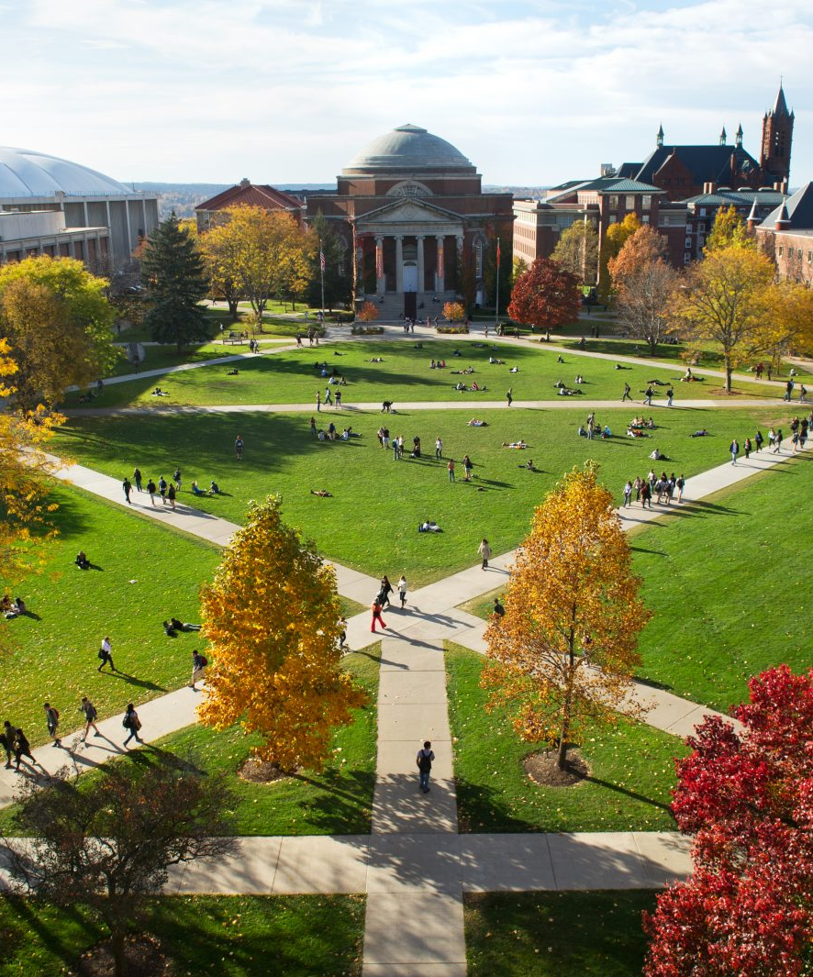
About Me

Slide 4
About Me
Courtney Zimmer-Bartels
University of Massachusetts – Amherst
B.A. in Astronomy (2006-2010)
Brooklyn, New York
Reis – Senior Analyst (2011-2016)
Xceligent – Analytics Manager (2016-2017)
Popular Bank – Business Analyst (2018-Present)

Slide 5
About Me
Volunteering
American Museum of Natural History
Scouts BSA
Why I sought out this program?

Slide 6

IST 687 – Introduction to Data Science
Summer 2019 Professor: Tin Hoang

Slide 7
IST 687 – Introduction to Data Science
Introduction
Group project using R to transform & analyze a dataset of our choosing
Analyzed Boston crime data paired with weather data
Has there been an increase in crime?
Does crime occur more frequently at a certain time, day, week, or month?
Is temperature a predictor of crime?
Data Source: Kaggle.com & NOAA website
github.com/czimmerb/Masters_Portfolio

Slide 8
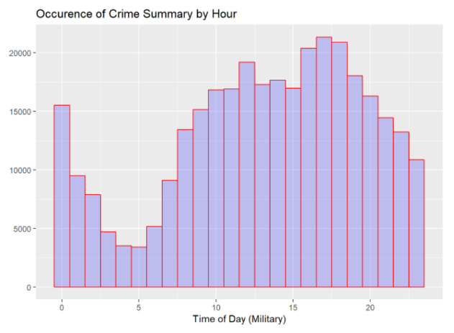
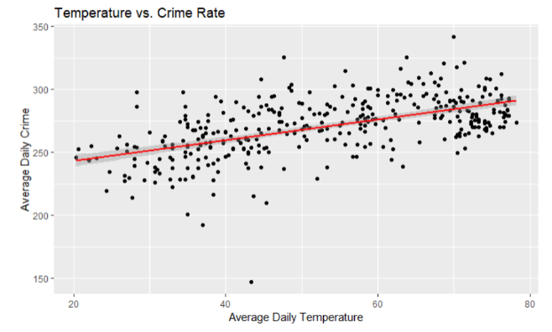
IST 687 – Introduction to Data Science
Exploratory Analysis
Year | Frequency of Crime | Number of Days | Average Occurrences Per Day
2015 | 53,392 | 199 | 268.3
2016 | 99,134 | 365 | 271.6
2017 | 100,938 | 365 | 276.5
2018 | 74,356 | 275 | 270.4
github.com/czimmerb/Masters_Portfolio

Slide 9
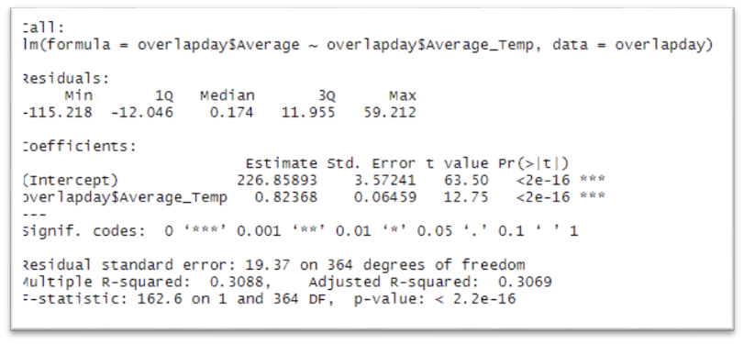
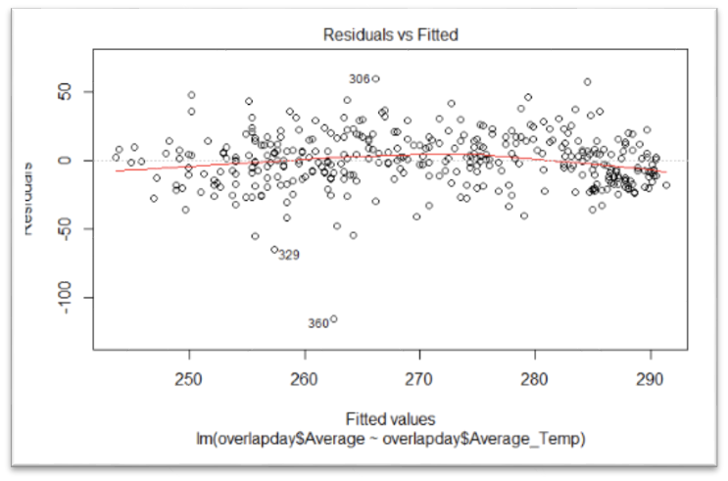
IST 687 – Introduction to Data Science
Modeling
Daily temp vs. daily crime rate
As temp increases by 1 degree, the daily occurrences of crime increases by 0.823
P-value 2e-16
Accounts for 30.7% of y values
github.com/czimmerb/Masters_Portfolio

Slide 10
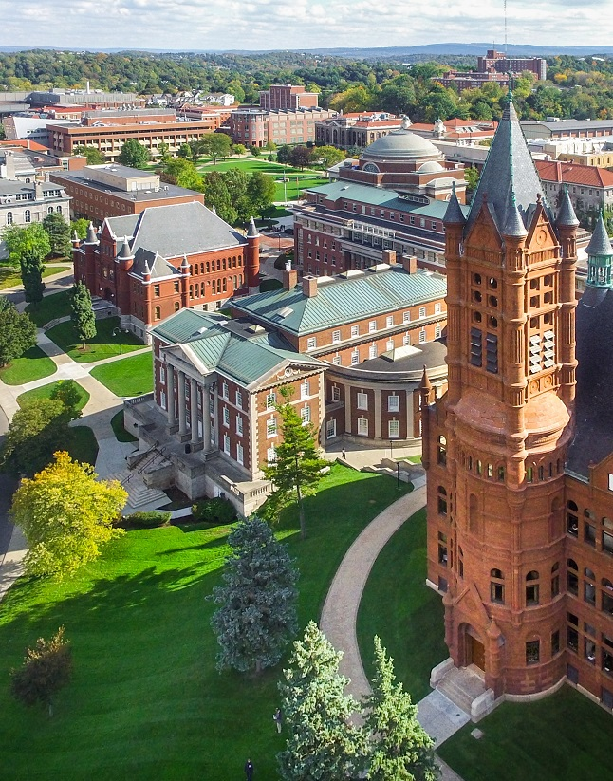
IST 707 – Data Analytics
Fall 2019 Professor: Dr. Jeremy Bolton

Slide 11
IST 707 – Data Analytics
Introduction
Group project solving a real-world data mining project, using R and a dataset of our choosing
Can we use historical NFL statistics to predict fantasy football points for players?
Data source: Kaggle.com
Game logs and career stats by position
Fantasy points calculation from FanDuel.com
Clustering, SVM, Association Rule Mining, Naïve Bayes, etc.
github.com/czimmerb/Masters_Portfolio

Slide 12
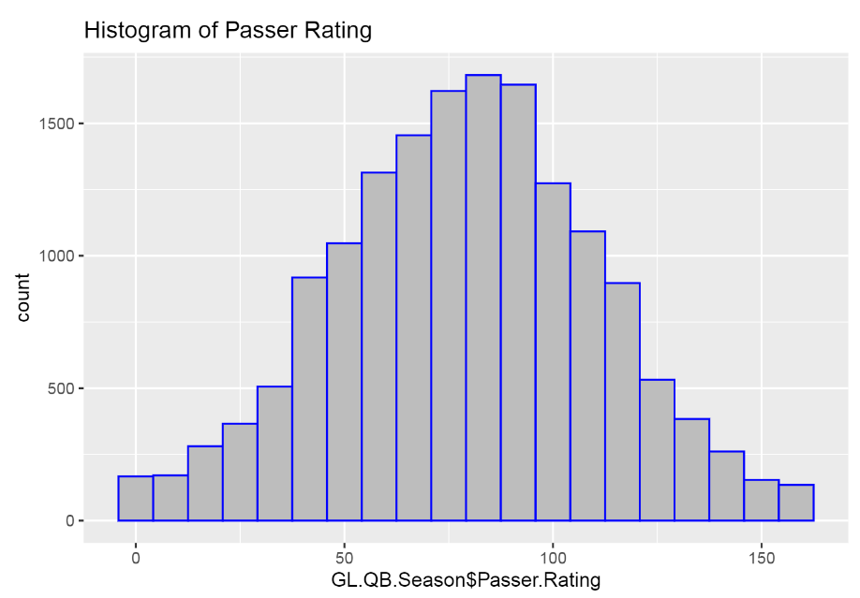
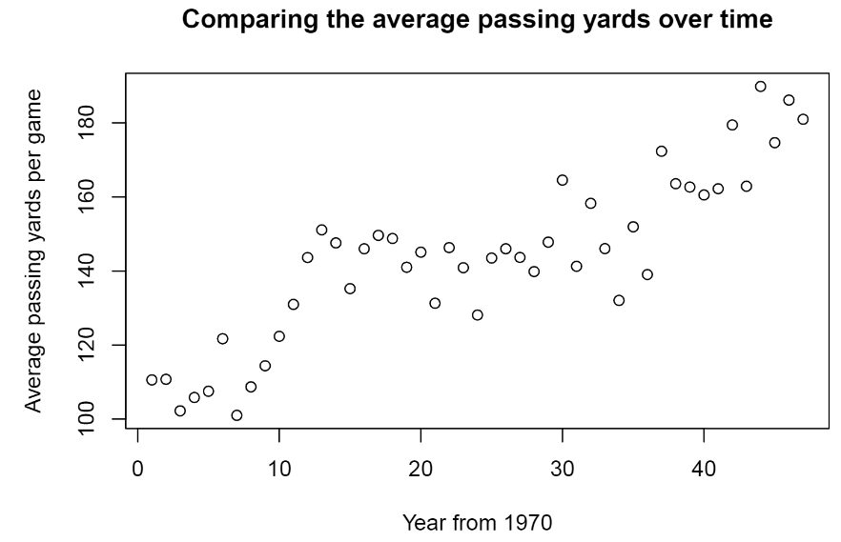
IST 707 – Data Analytics
Exploratory Analysis
github.com/czimmerb/Masters_Portfolio

Slide 13
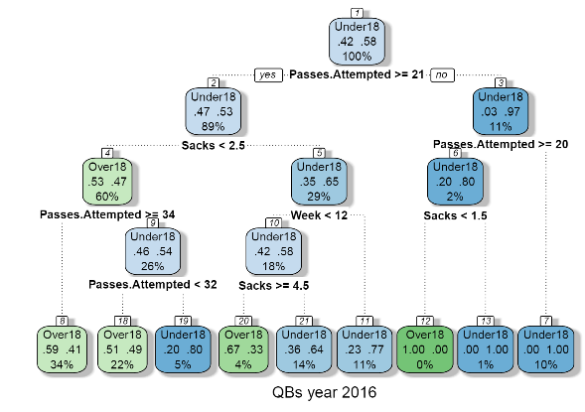
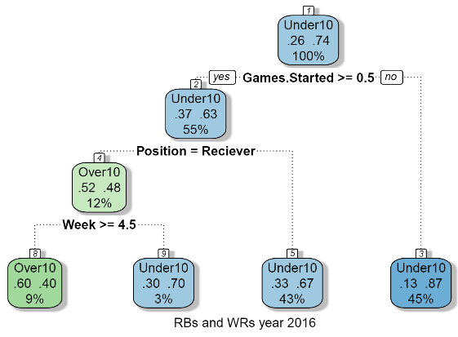
IST 707 – Data Analytics
Decision Trees
A QB has a 68% chance of getting 18+ fantasy points if passes attempted > 21, sacks <= 2 & its week 8 or further in the season.
A running back who started the game has a 71% chance of scoring 10 or more fantasy points, supported by 43% of the data.
github.com/czimmerb/Masters_Portfolio
Notes:
Decision tree model data was split into 2016 and 2010-2016 data. Models shown in the slide only represent the 2016 model results.

Slide 14
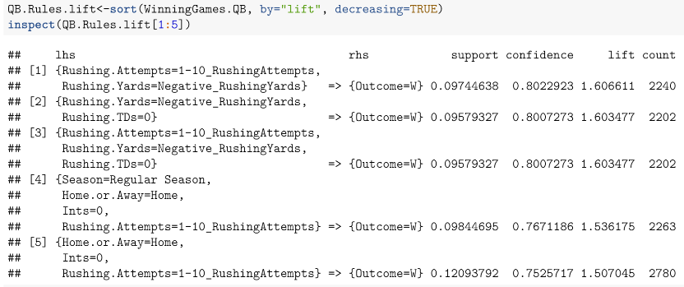
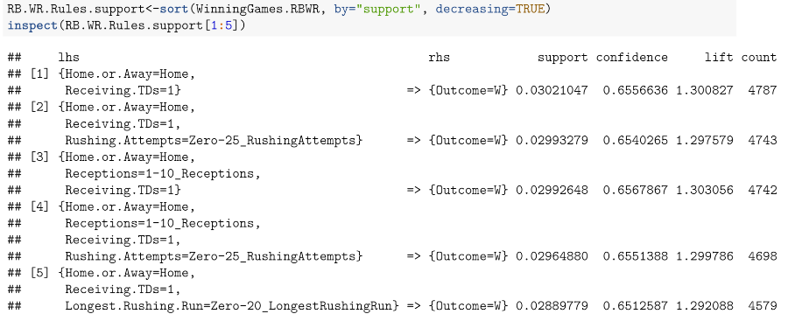
IST 707 – Data Analytics
Association Rule Mining
Right-hand set to ‘Outcome = Win’
QB & running back/wide receiver
Sorted by support, confidence and lift
Home.or.Away = Home
github.com/czimmerb/Masters_Portfolio

Slide 15

IST 722 – Data Warehouse
Spring 2020 Professor: Humayun Khan

Slide 16
IST 722 – Data Warehouse
Introduction
Group project to build a DW/BI solution that can work to answer a business process question regarding two subsidiary companies with separate databases.
Data Source: Fudgemart & Fudgeflix databases
Customer satisfaction reporting
Microsoft Excel, SQL Server Management Studio, Visual Studio and Power BI
github.com/czimmerb/Masters_Portfolio

Slide 17
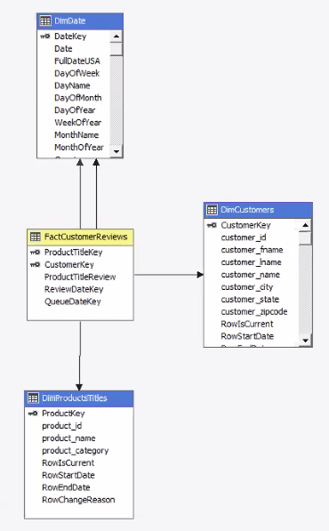
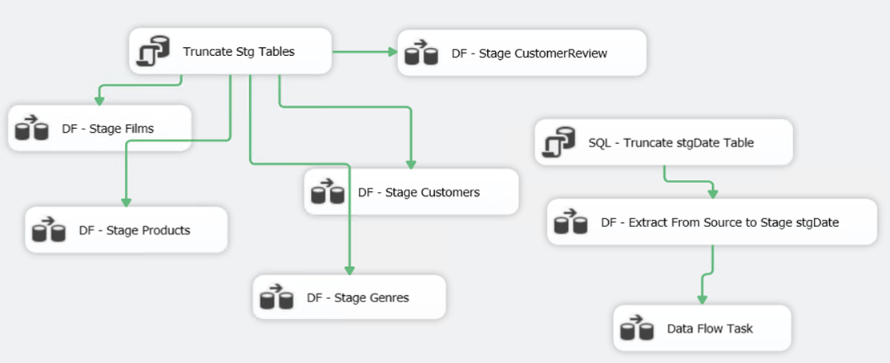
IST 722 – Data Warehouse
Star Schema
Project charter
High-level dimension modeling
Detail dimension modeling
Implementation
github.com/czimmerb/Masters_Portfolio

Slide 18
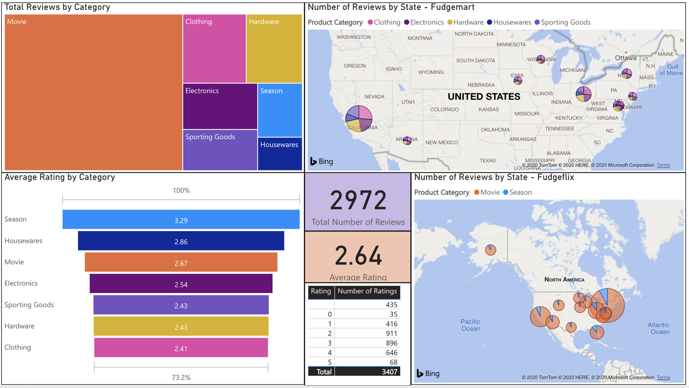
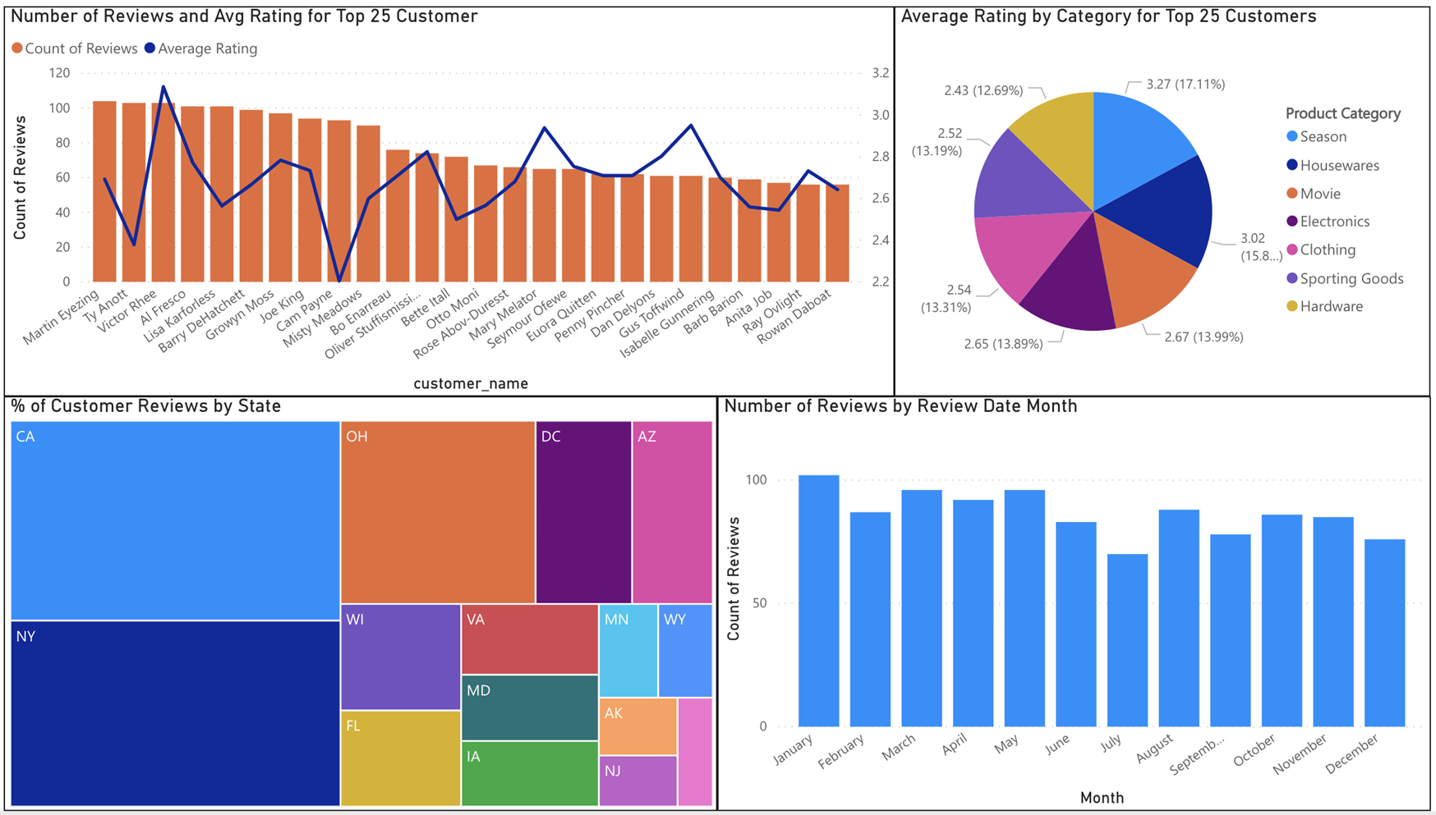
IST 722 – Data Warehouse
Power BI Dashboard
github.com/czimmerb/Masters_Portfolio

Slide 19

IST 719 – Information Visualization
Summer 2020 Professor: Gary Krudys

Slide 20
IST 719 – Information Visualization
Introduction
Create an information visualization poster
Data Source: Hass Avocado Board – weekly sale/price data
Graphs created using R & poster created in Adobe Illustrator
Questions
Is there an area where organic avocados outsell conventional ones?
Understanding avocado price distribution
Has avocado popularity translated to an increase in sales?
github.com/czimmerb/Masters_Portfolio

Slide 21
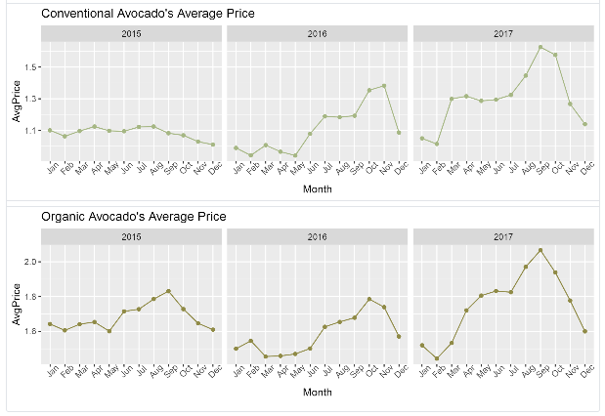
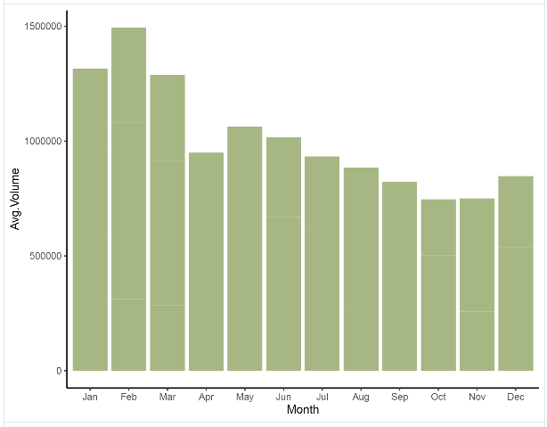
IST 719 – Information Visualization
Visualizations
github.com/czimmerb/Masters_Portfolio

Slide 22
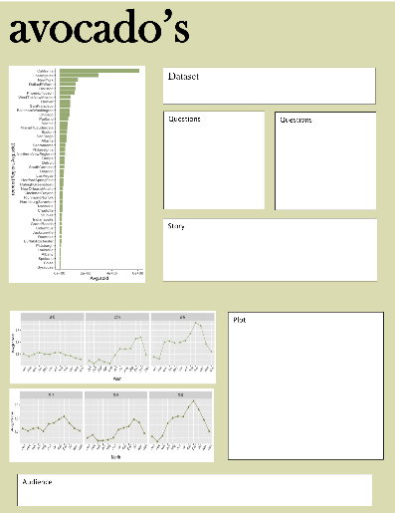
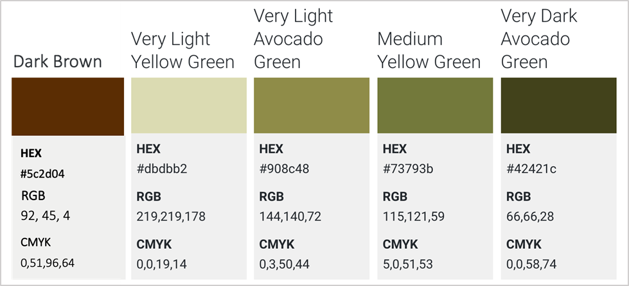
IST 719 – Information Visualization
Design Elements
Color, font & work-in-progress layout
Georgia
github.com/czimmerb/Masters_Portfolio

Slide 23

Learning Goals

Slide 24
Learning Goals
1.) Describe a broad overview of the major practice areas of data science
Exemplified by Intro to Data Science & Data Analytics
Using descriptive analytics to understand your data
Models to predict and forecast data
Using the analysis to make recommendations

Slide 25
Learning Goals
2.) Collect and organize data
Demonstrated in all projects
Information Visualization required collecting separate files for each of the 4 years available and then merging that data. As well as segmenting the data by total US, regions and areas

Slide 26
Learning Goals
3.) Identify patterns in data via visualization, statistical analysis, and data mining.
All project demonstrated one form of identifying patterns
Data Warehouse with the use of Power BI
Intro to Data Science with its exploratory analysis
Data Analytics with its vast use of data mining tools & accuracy charts
Information Visualization with answering questions using visuals in an information poster

Slide 27
Learning Goals
4.) Develop alternative strategies based on the data.
Initial strategies developed in the data warehouse course proved to be difficult to implement
Forced to revisit about business process question

Slide 28
Learning Goals
5.) Develop a plan of action to implement the business decisions derived from the analyses.
Intro to Data Science, Boston crime data project resulted in some interesting findings
Staffing and scheduling of police in Boston could benefit from our results

Slide 29
Learning Goals
6.) Demonstrate communication skills regarding data and its analysis for managers, IT professionals, programmers, statisticians, and other relevant professionals in their organization.
All projects required some level of communication of the findings
Information Visualization highlighted the need for understanding your audience and how to communicate effectively

Slide 30
Learning Goals
7.) Synthesize the ethical dimensions of data science practice.
Data Warehouse taught the importance of instituting proper data procedures
Understanding how your data is structured and stored
Data integrity

Slide 31
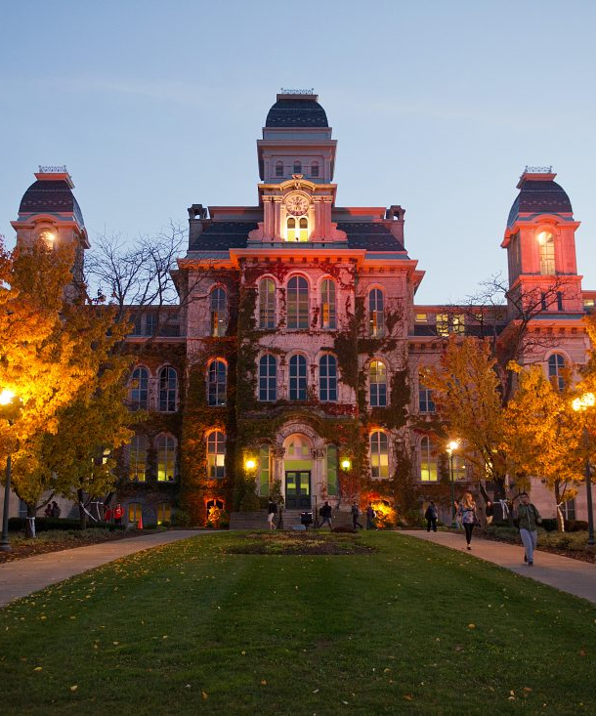
Takeaways

Slide 32
Takeaways
Not only technical skills gained
Confidence to know I can effectively collect data, whether it is creating a data warehouse solution, or creating a comprehensive survey
Analyze data, both using exploratory analysis and statistical modeling
Develop strategies and recommendations based on my findings
Instituting implementation of my recommendations

Slide 33
Thank You
Courtney Zimmer-Bartels
Masters Portfolio Milestone
SUID: 617132274
czimmerb@syr.edu
github.com/czimmerb/Masters_Portfolio

